Slide 1

STARBUCKS SALES REPORT

Slide 2

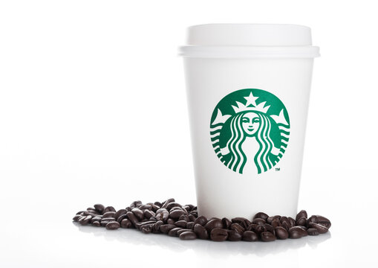
FIRST OF ALL LET ME EXPLAIN YOU MY PROJECT, I HAVE BEEN GIVEN STARBUCKS SALES DATA WHERE I HAVE TO VISUALIZE , INTERPRETE AND MAKE DASHBOARD.
I HAVE USED PIVOT TABLE, HISTOGRAM,CHARTS,MATHEMATICAL FUNCTIONS,TEXT FUNCTIONS AND FILTER TO VISUALIZE GIVEN DATA .

Slide 3


starbucks

Slide 4
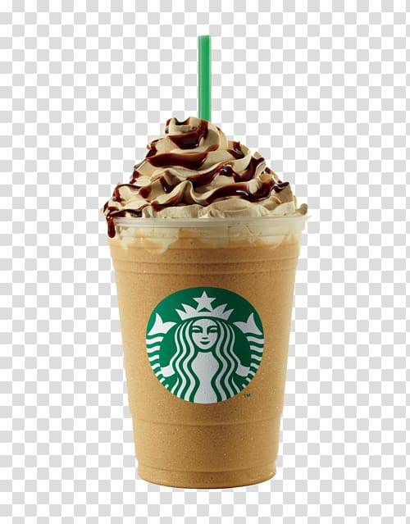
Goal: To understand the gender distribution of Starbucks customers.
This chart shows the proportion of male and female customers. If there is a significant gender imbalance, targeted marketing campaigns can be developed to attract the underrepresented gender.
Loyalty Programs:
Create a loyalty program that rewards customers for repeat purchases.
Offer a free coffee after a certain number of purchases.

Slide 5
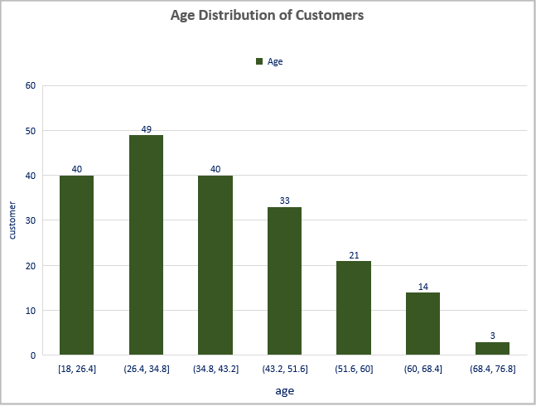
Goal: To visualize the age distribution of Starbucks customers.
visualize the age distribution of Starbucks customers. Knowing the age demographics will enable Starbucks to better target its services and products to different age groups.
This chart shows distributation of customer between different ages.
customer within the age range of 50-77 are not much interested in purchasing. we can offer 10% discount to target customers and run customized advertisement campaign
Provide discounts for bulk purchases, such as buying coffee beans in larger quantities.

Slide 6
Goal: To compare the average purchase amount between genders.
gain deeper insights into purchasing behaviors, you need to compare the average purchase amount between male and female customers. This could reveal if there's a significant difference in spending patterns based on gender.
Interpretation of Visualizations:
Average Purchase by Gender:
This chart shows the proportion of male and female customers. If there is a significant gender imbalance, targeted marketing campaigns can be developed to attract the underrepresented gender.
Special Offers and Discounts:
Run time-limited promotions, such as “Buy One, Get One Free”
or discounts during off-peak hours.
Provide discounts for bulk purchases, such as buying coffee
beans in larger quantities.

Slide 7
Understanding how frequently customers visit Starbucks at different locations can help identify which stores are the most popular and why. This information is vital for operational efficiency and marketing efforts.
Goal: To understand the frequency of visits across different locations.
this chart shows the proportion of customer and location.
stores located in east michael are the most popular among customer reason for popularity is young customer in this location
Social Media and Online Marketing:
Use social media platforms to showcase new drinks, promotions,
and customer testimonials.
Run targeted online ads and use influencer marketing to reach
a broader audience.

Slide 8
You want to analyze the average purchase amount for different age groups. By categorizing customers into age groups, Starbucks can better tailor its offerings to meet the preferences of each age segment.
Goal: To analyze the average purchase amount for different age groups.
this chart shows the purchasing power of customer among different age groups.
age group of 26-35 is targeted customer. we can offer french fry with diffrent items to enhance purchasing
Email Marketing:
Build an email list and send out regular newsletters with updates, promotions, and coffee-related content.
Offer exclusive discounts to email subscribers.

Slide 9
Goal: To find out the percentage of customers who have made a purchase at Starbucks.
Your manager is keen to know what percentage of the customer base has made a purchase at Starbucks. This will help gauge customer engagement and the effectiveness of loyalty programs.
Interpretation of Visualizations
Percentage of Customers Who Purchased at Starbucks
this chart shows the percentage of customer coming at starbucks.62.56% of customer are having coffee. selling of pastries among all is lowest. we can serve pastry as a complimentry dise who are purchasing above 500

Slide 10
Visualizing how often customers visit Starbucks can shed light on customer loyalty and satisfaction levels. Frequent visits might indicate high customer satisfaction and engagement.
Goal: To visualize how often customers visit Starbucks.
Interpretation of Visualizations
Customer Frequency Distribution
this chart shows the distribution of customer among different food items. 122 of customer are having coffee. selling of pastries among all is lowest. we can serve pastry as a complimentry dise who are purchasing above 500

Slide 11
You aim to see if there's a correlation between customer age and their average purchase amount. Understanding this relationship can help in designing age-appropriate marketing strategies and product offerings.
Goal: To see if there is a correlation between customer age and average purchase amount.
Interpretation of Visualizations
Customer Age vs. Average Purchase
this chart shows the purchasing power of customer among different age groups.
age group of 26-35 is targeted customer. we can offer french fry with diffrent items to enhance purchasing

Slide 12
Goal: To identify high-spending customers (e.g., those with an average purchase above a certain threshold).
Finally, identifying high-spending customers will allow Starbucks to create targeted marketing campaigns and loyalty programs to reward and retain these valuable customers.
Interpretation of Visualizations
High-Spending Customers
this chart shows that those who are purchasing above $30 are high spending customers so we offer combo deals, no category customer can be offered buy one get one free.

